Slide 1

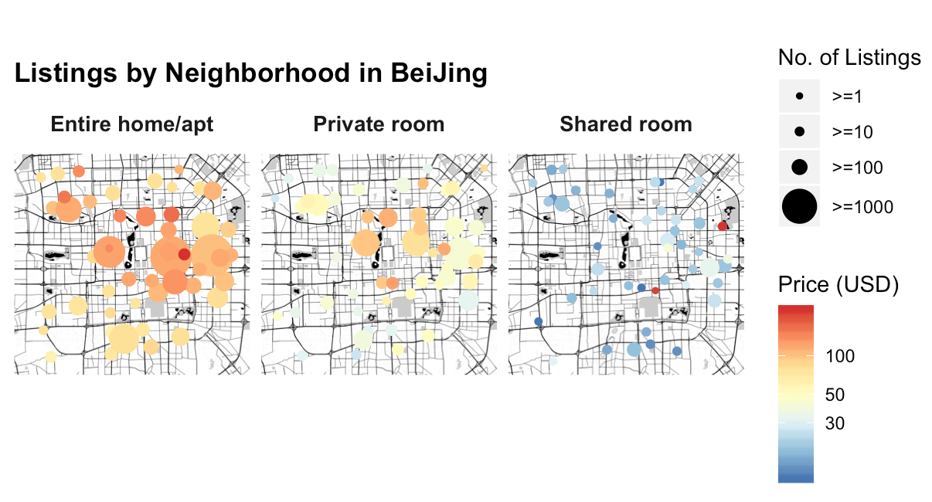
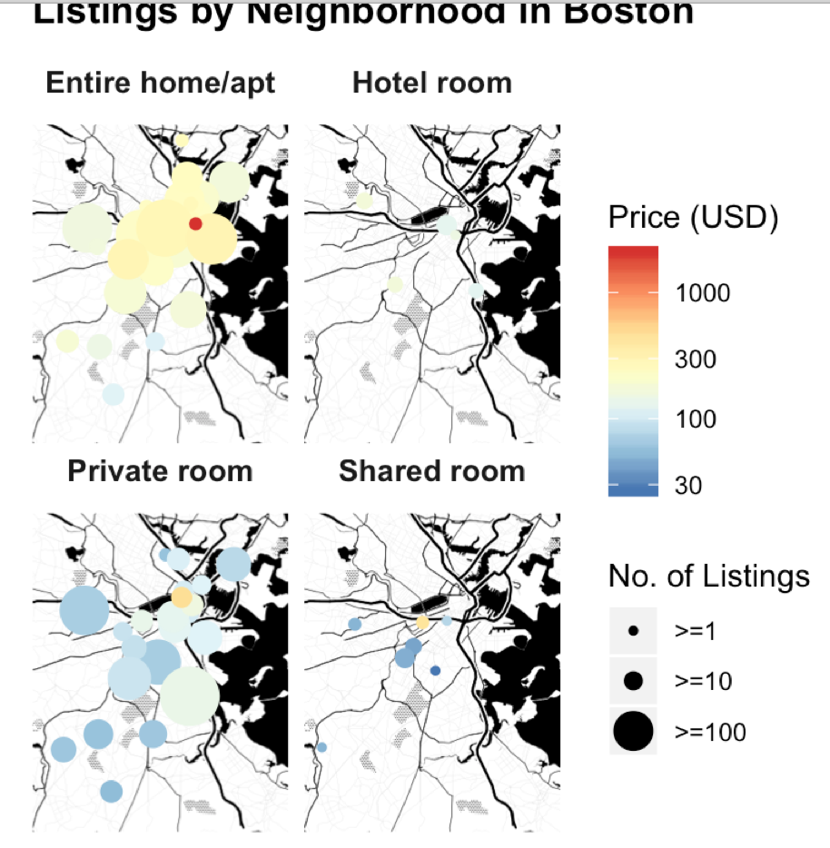
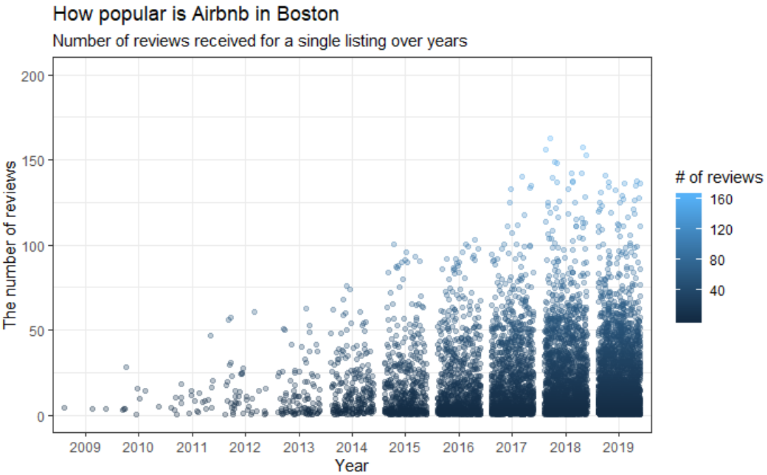
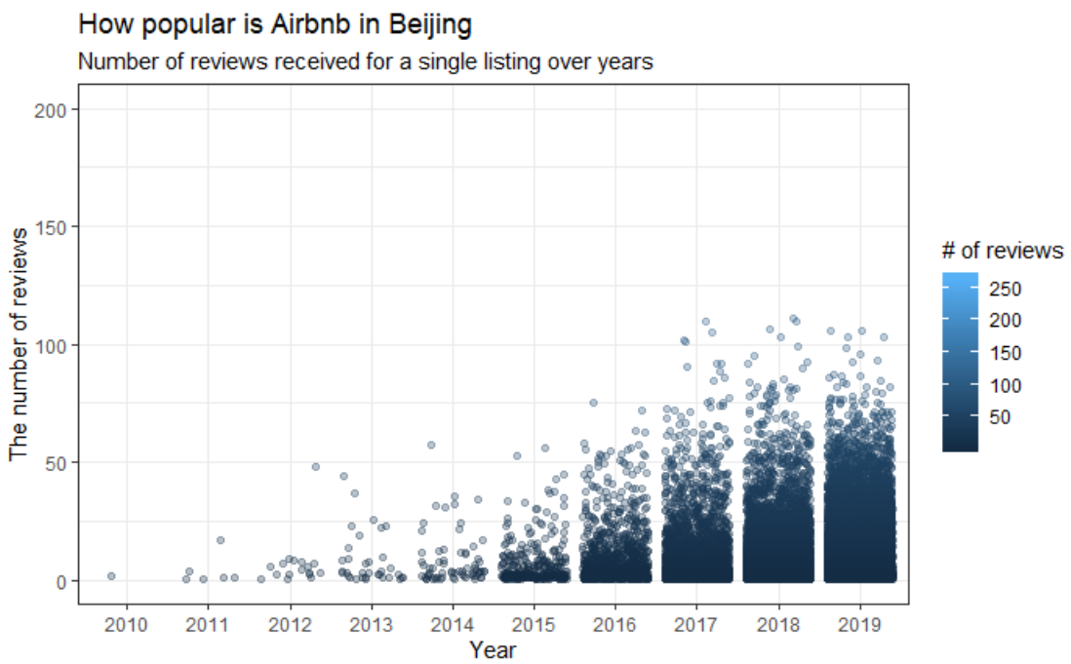
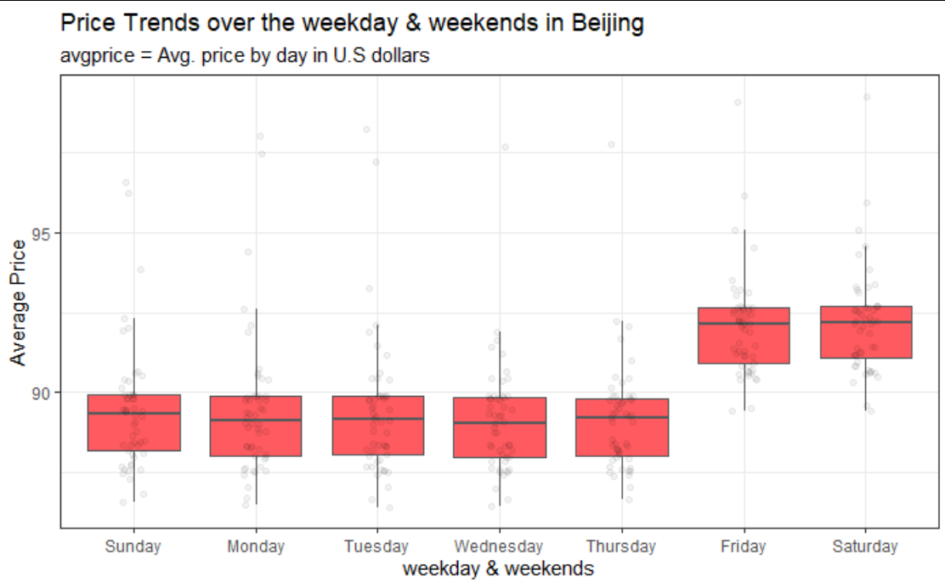
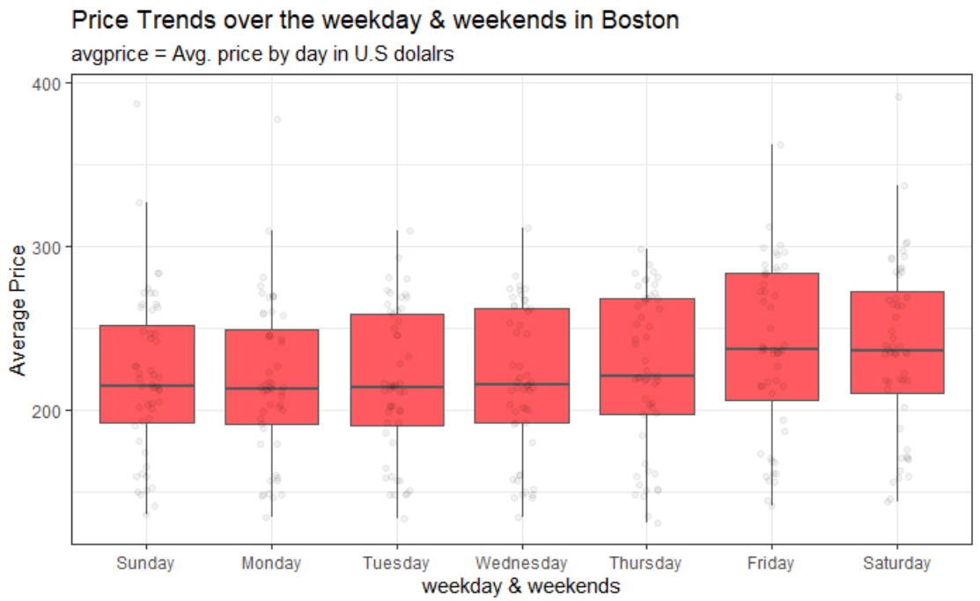
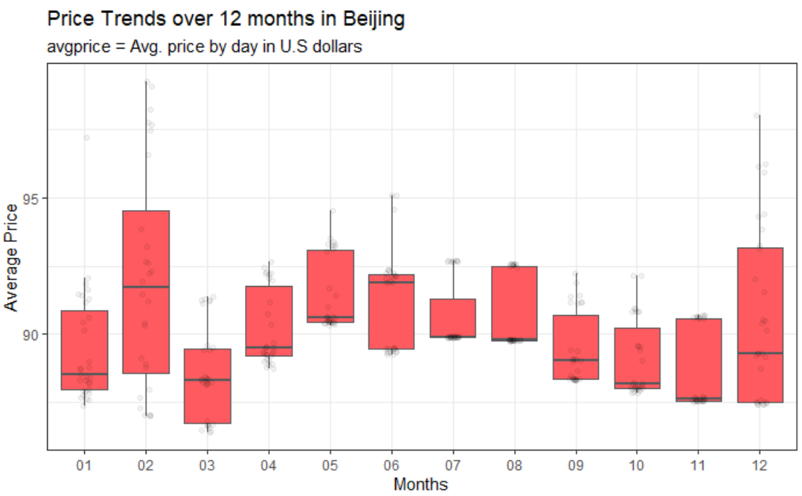
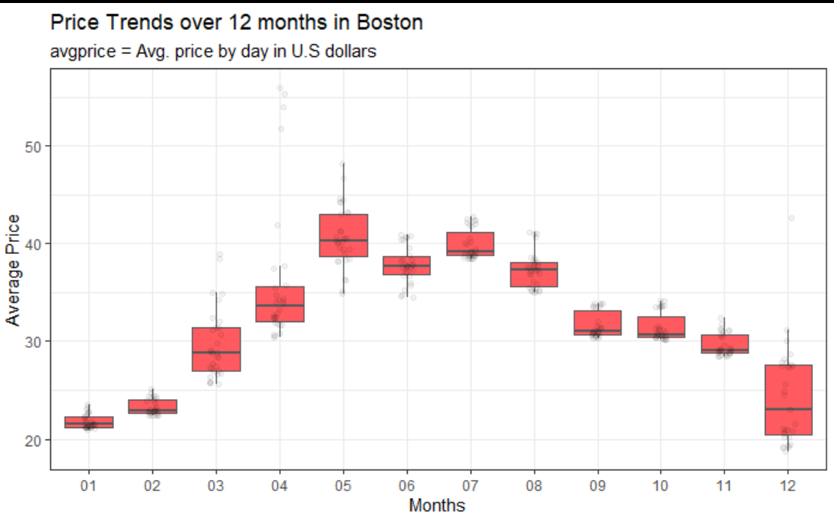
Airbnb Listings Analysis for Beijing & Boston
Team 4B, Cohort B, MSBA’20
Questrom School of Business
Abstract
Methodology
Results
Conclusion
This study analyzes the comparison of demand and supply between Airbnb homestays in Beijing and Boston by establishing a supervised machine learning model of housing price, obtaining the influencing factors of the prices in the two cities, and implementing unsupervised machine learning models to build Airbnb homeowners (hosts) and customers (visitors) profiles.
With the techniques above, we dig into the external differences in the Airbnb marketplaces between China and the United States, and provide reference opinions for homestay hosts in the pricing area. At the same time, through sentiment analysis of homestay reviews, this study hopes to obtain relevant factors that affect the preferences of Airbnb consumers in China and the United States, which helps hosts to improve their quality of homestays and be in comparative advantage in market competition. At the company level, this study also conducted a comparative analysis of the competitor of Airbnb (booking.com) to obtain the differences in pricing factors between the two and guided Airbnb's future external competition.
Exploratory Data Analysis
Price & Number of Listings by Neighborhoods
Popularity of Airbnb Across Years
Price Trends by Weekdays & Weekends and by Season
Supervised Machine Learning: Pricing Modeling
Boruta Feature Selection with Random Forest
Lasso Regression
Boosting
Unsupervised Machine Learning: Customer Profiles
Text Analysis for Comments and House Descriptions
Add your information, graphs and images to this section.
Add your information, graphs and images to this section.
Dataset Description
Intro to Data
Beijing and Boston Airbnb datasets, each has three sub-datasets, listings, reviews and calendar.
Beijing listing datasets, we have 106 variables and for Boston listings dataset we have 108 variables. This dataset includes all basic information about the room/house for rent on Airbnb, for example, the name of the list, description of the listing, transit, and review scores, ect. We cleaned these data by removing needless columns, removing columns with over 60% NA observations and also removing some special variables that are mostly missing values and uncorrelated with our research, such as license, jurisdiction_names, ect. Data are from Dec 2009 to Dec 2019.
Beijing and Boston reviews datasets, we both have 9 variables. This dataset includes all reviews that have been given to the listing home. We did a timestamp clean and lubricate version for reviews of Boston and Beijing. Data are from Dec 2009 to Dec 2019.
Beijing and Boston calendar datasets also have 9 variables after data cleaning. For the calendar datasets, it has the future price in the following year, listing id, availability, ect. We took the data from December 2018, and then got the price of all listings from Dec 2018 to Dec 2019.
Handling of Variables & Missing Values
Transfer Text Information and Categorical Variables into Dummies. Example: {Cable TV; TV; WIFI; Air-Conditioning} to “TV_Available” ; “WIFI_Available” ; “Air_Conditioning”
Use Median and Mean Based on Neighborhoods and Types of Houses to Replace N.A for Security Deposit and Cleaning Fee
Remove Observations Without Information of Host Response Time and Rate
Remove Observations Without Review Scores
Acknowledgements
Add your information, graphs and images to this section.

